Slide 1

Real-Time Traffic Flow Analysis using Poisson and Markov Chains
UBA 5326 PROBABILISTIC METHOD AND LINEAR ALGEBRA
Guided By:
Dr.M.Rameswari Dr. Gowri Senthil
Presented By:
Devadharshini E-[192524483]
Janani B-[192521052]

Slide 2


AGENDA
Literature Review
Introduction
Objectives
Module 1
Module 2
Future Scope
Conclusion
References

Slide 3
LITERATURE REVEIW
Author (Year) | Method Used | Main Idea | Limitation | Author (Year)
Besenczi et al. (2021) | Markov Model | Used Markov chains to simulate traffic flow in large road networks | Needs large data and computation | Besenczi et al. (2021)
El Fawal et al. (2024) | MMPP (Poisson + Markov) | Combined Poisson and Markov to model dynamic traffic | Complex model | El Fawal et al. (2024)
Joubari et al. (2022) | Markov Chain | Modeled vehicle movement in multi-lane highways | Only for highways | Joubari et al. (2022)
El Fawal et al. (2024) | MMPP | Modeled heterogeneous traffic systems | High complexity | El Fawal et al. (2024)
Poisson Models | Poisson Distribution | Used for vehicle arrival prediction | Assumes independent traffic | Poisson Models

Slide 4
INTRODUCTION
With the rapid growth of urban populations and vehicles, traffic congestion has become a critical problem in cities worldwide.
Real-time traffic analysis helps in predicting congestion patterns, optimizing signal timings, and improving road safety.
This project combines Poisson distribution for modeling vehicle arrivals and Markov Chains for predicting traffic congestion in the next time interval, offering a statistical and predictive approach for traffic management.

Slide 5
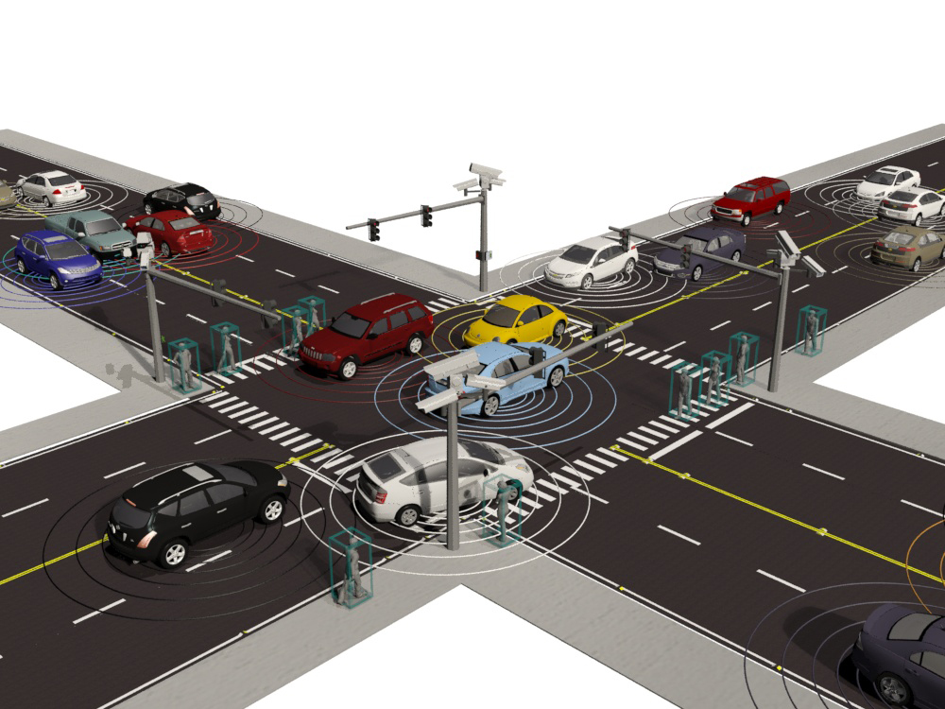
PROBLEM STATEMENT
Traditional traffic monitoring systems rely on fixed schedules or manual observation, which cannot efficiently handle dynamic traffic patterns. This leads to poor congestion management and delays. Existing systems fail to accurately predict these variations in real time.

Slide 6
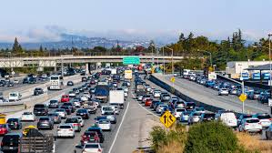
OBJECTIVES
To model the number of vehicles passing through a road segment per minute using Poisson distribution.
To predict the next-state traffic congestion (Low, Medium, High) using Markov Chains.
To provide insights that can help in traffic signal optimization and urban planning.

Slide 7
MODULES OVERVIEW
The system is divided into two main modules: Module 1: Vehicle Arrival Modelling (Poisson Distribution) Module 2: Traffic Congestion Prediction (Markov Chain)
Each module performs specific functions to ensure smooth working of the system.

Slide 8

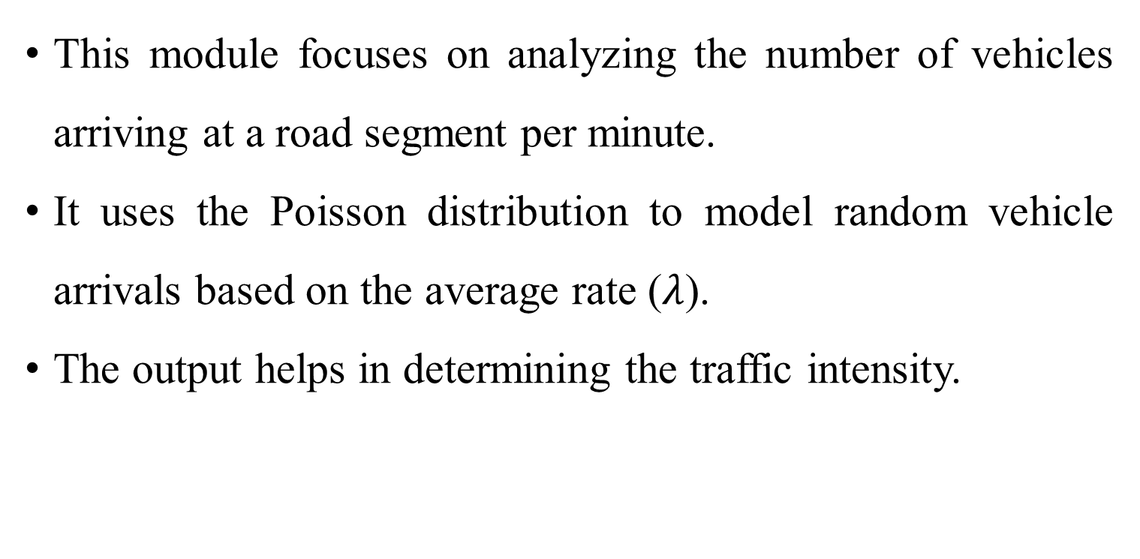
Module 1: Vehicle Arrival Modelling (Poisson Distribution)
This module focuses on analyzing the number of vehicles arriving at a road segment per minute.
It uses the Poisson distribution to model random vehicle arrivals based on the average rate ($λ$).
The output helps in determining the traffic intensity.
k = number of vehicles arriving per minute
λ\lambdaλ = average number of vehicles per minute

Slide 9
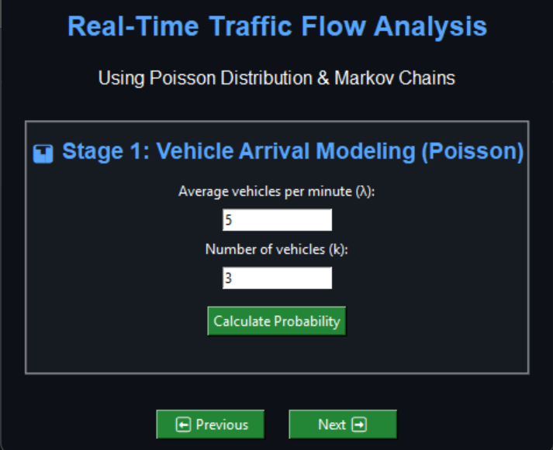
MODULE 1 OUTPUT

Slide 10
Module 2: Traffic Congestion Prediction (Markov Chain)
This module predicts the next traffic condition using Markov Chains.
Based on the current traffic state (Low, Medium, High), it uses a transition probability matrix to estimate the next state of congestion.
The next-state probability depends only on the current state (Markov property).

Slide 11
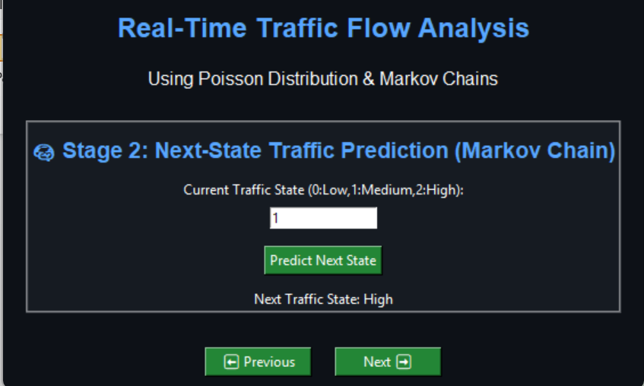
MODULE 2 OUTPUT

Slide 12
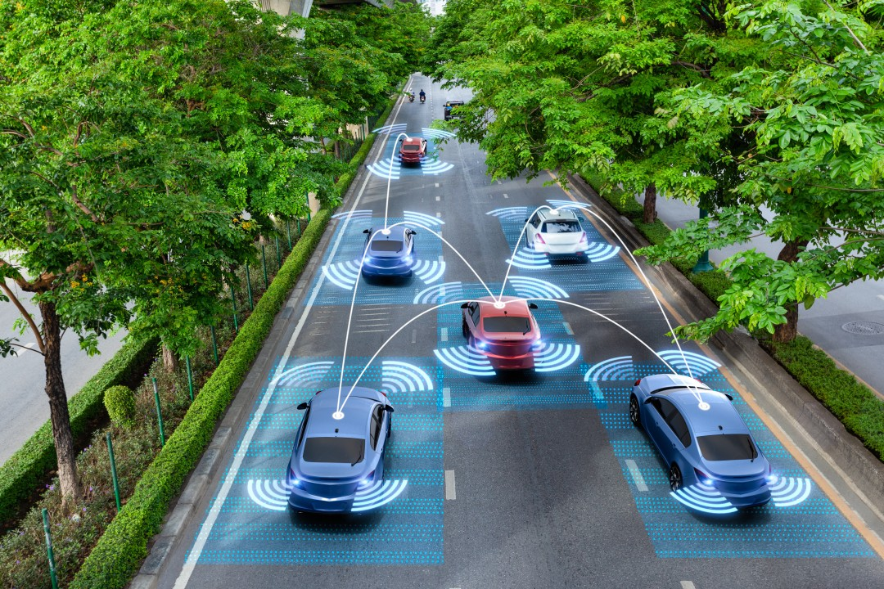
FUTURE SCOPE
Extend to multi-lane and multi-road networks with dynamic transition probabilities.
Combine with machine learning algorithms for improved prediction accuracy.
Develop mobile or web applications for public access to real-time traffic
predictions. Incorporate weather and accident data to refine traffic prediction models.

Slide 13
CONCLUSION
This project demonstrates a statistical and predictive approach to traffic analysis.
Poisson distribution effectively models vehicle arrivals, while Markov Chains provide a simple yet powerful method for predicting traffic congestion.
The integration of these modules in a real-time system helps traffic authorities make proactive decisions, optimize signal timings, and reduce congestion.

Slide 14
REFERENCES
Besenczi, Renátó, Norbert Bátfai, Péter Jeszenszky, Roland Major, Fanny Monori, and Márton Ispány. "Large-scale simulation of traffic flow using Markov model." Plos one 16, no. 2 (2021):
e0246062.El Fawal, Ahmad Hani, Ali Mansour, and Abbass Nasser. "Markov-modulated Poisson process modeling for machine-to-machine heterogeneous traffic." Applied Sciences 14, no. 18 (2024):
8561.Joubari, Oumaima EL, Jalel Ben Othman, and Véronique Vèque. "Markov chain mobility model for multi-lane highways." Mobile Networks and Applications 27, no. 3 (2022):
1286-1298.El Fawal, Ahmad Hani, M. A. N. S. O. U. R. Ali, and Nasser Abbass. "Markov Modulated Poisson Processes Modelling for M2M Heterogeneous Traffic." (2024).
Sheldon. M. Ross, Introduction to Probability and Statistics for Engineers and Scientists, Elsevier Academic Press, California, 4th Edition, 2009

Slide 15


